Slide 1
Basic Call Flow Introduction (Preface)
Kavon Ma
July, 2013

Slide 2
SIP-SIP call flow
A
MGC-8
B
Invite
Invite
100 trying
100 trying
180 ringing
180 ringing
200 OK invite
200 OK invite
ACK
ACK
talking
Bye
Bye
200 OK bye
200 OK bye
Basic ISUP-SIP call flow

Slide 3
ISUP-ISUP call flow
A
MGC-8
B
IAM
IAM
ACM
ACM
ANM
ANM
talking
REL
REL
RLC
RLC
Basic ISUP-ISUP call flow

Slide 4
ISUP-SIP call flow
A
MGC-8
B
IAM
Invite
180 ringing
ACM
200 OK invite
ANM
talking
REL
Bye
RLC
200 OK bye
Basic ISUP-SIP call flow

Slide 5
SIP-ISUP call flow
A
MGC-8
B
Invite
IAM
100 trying
ACM
180 ringing
200 OK invite
ANM
talking
REL
Bye
RLC
200 OK bye
Basic ISUP-SIP call flow

Slide 6
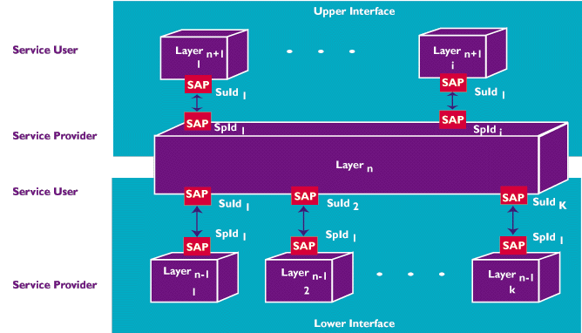
Inter-Layer Communication

Slide 7
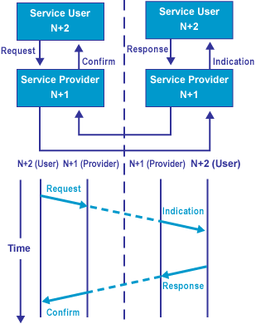
Primitives
An interaction between a service user and service provider at a SAP occurs via a set of well-defined functions known as primitives.
Each primitive is usually associated with one of four actions:
- Request
- Indication
- Response
- Confirm

